Slide 1
Volatility Harvesting From
Dynamic Rebalancing
Group 2
LOST
Chua Yi Yuan
Gong Chao
Li Zehao
Long Ye
You Yuquan
Zhao Enping

Slide 2
Literature Review
2012
2014
2015
Volatility Harvesting:
Why Does Diversifying and Rebalancing Create Portfolio Growth?
Disentangling rebalancing return
Volatility Harvesting in Theory and Practice
Volatility harvesting is a strategy to gain excess compounded return generated from rebalancing volatile assets over multiple time periods.
Rebalanced portfolio tends to have a lower volatility and a higher Sharpe ratio than the B&H portfolio. Volatility return depends on assets’ average correlation and volatility, and it change with rebalancing frequency
Rebalancing is a source of excess return that relies on the cross-sectional volatility of the securities in the market, as well as the long-term stability of the market-capitalization distribution.

Slide 3

Issues/problems
01
All literature empirical evidence test volatility harvesting using fixed rebalancing frequency
02
High rebalancing frequency can lead to expensive transaction cost
03
We are trying to find ways to determine rebalancing frequency in our research

Slide 4
Research Design
In order to optimize volatility harvesting strategy, we will select assets with low correlation and high volatility
1. Assets Selection
2. Capital Allocation
For each rebalancing, 80% mark to market portfolio value in risky portfolio and 20% in cash with zero risk and return
VIX and implied correlation signals for rebalancing
Evaluating volatility harvesting strategy from dynamic rebalancing performance with benchmark portfolios
3. Signals
4. Backtest

Slide 5
Research Design – Data
17 assets of equity index, commodity futures with 15 years daily price and daily 3M-maturity option 90%, 100% and 110% moneyness implied volatility
01
02
15 years VIX index daily price
03
15 years FX daily price for conversion in backtesting
04
Split dataset into 2 sets - 3 years for training and 12 years for backtesting

Slide 6
Research Design – Performance Evaluation
Performance Evaluation
Volatility harvesting with implied correlation and VIX
80% in risky portfolio and 20% in cash. Equal weight** rebalancing based on implied correlation and VIX signal
Volatility harvesting with implied correlation
80% in risky portfolio and 20% in cash. Equal weighted** rebalancing based on implied correlation signal
Benchmark rebalanced portfolio
100% capital in 17 assets* with monthly rebalancing
Benchmark portfolio B&H
100% capital in 17 assets* without rebalancing
*All portfolio construction are vol-weighted
** Equal notional value weighted between pairs

Slide 7



Methodology
Where is rebalancing premium from?
$$g_{p}= \sum_{i=1}^{N}{w_{i}g_{i}+ \frac{1}{2}\left(\sum_{i=1}^{N}{w_{i}σ_{i}^{2} − \sum_{i,j=1}^{N,M}{w_{i}σ_{ij}w_{j}}}\right)}$$
$$=Average Growth+ 1/2Average Variance$$
$$− 1/2Portfolio Variance$$
$$=Average Growth+Rebalancing Premium$$
This formula explains rebalancing premium can be optimized by choosing high individual asset volatile and low correlation portfolio.

Slide 8
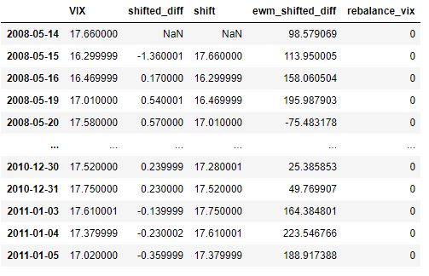
Methodology – VIX
VIX Introduction:
CBOE Volatility Index (VIX) is a real-time index that represents the market's expectations for the relative strength of near-term price changes of the S&P 500 index (SPX). It generates a 30-day forward projection of volatility.
VIX Signal:
01
Calibrated VIX target level
02
Daily VIX level changes
Changes in Exponential moving average on daily price
03

Slide 9
Methodology – Implied Correlation
Implied Correlation Index:
VIX index is an important measure for “market fear” and well known in practice. Correlation is paid less attention.
01
The CBOE launched its implied correlation indexes in 2009 based on the S&P 500 index. The correlation index is an index that tracks the correlation between the implied volatilities of index options and the weighted implied volatilities of options on the index components.
02
03
Similar to VIX Index, implied correlation exhibits a tendency to increase when the S&P 500 decreases.

Slide 10
Methodology – Volatility Skew
Changes in skewness:
Skewness derives from difference between implied volatilities of 90% and 110% moneyness options (or Risk-reversal)
01
Reverse skew is the situation where implied volatility on the lower options strike is higher. It occurs when investors purchase put options to compensate for the downside risk. It is commonly observed in index option
02
Forward skew is the situation where implied volatility on the higher option strike is higher. This is commonly observed in commodity markets.
03
04
Changes in volatility skewness reflect market expectation (but how far forward?)

Slide 11
Methodology – Implied volatility Skew correlation
Our correlation signal:
01
We have 17 assets available to construct portfolio and hence 136 pairs in total
Derive each pairs daily skewness changes through implied volatility and then obtain implied correlation accordingly
02
03
Derive actual rolling correlation based on daily return
Obtain optimal shift of each pair by matching implied correlation to actual correlation and store it for future rebalancing forecasting
04
Set implied correlation quantile to filter qualified pairs to construct portfolio on daily basis. Any changes in portfolio component will lead rebalancing.
05

Slide 12
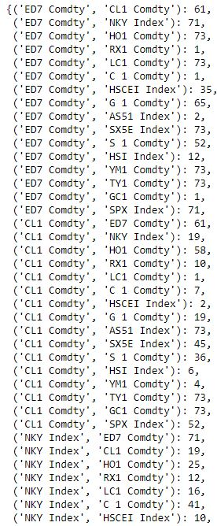
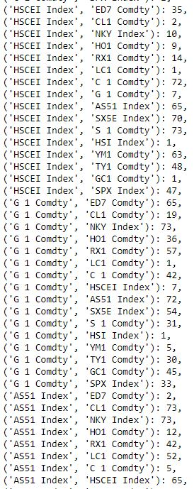
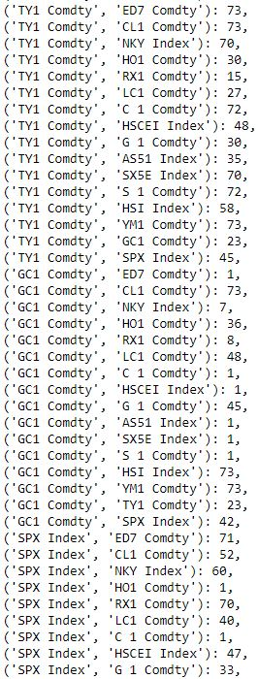
Methodology – Implied volatility Skew correlation

Slide 13
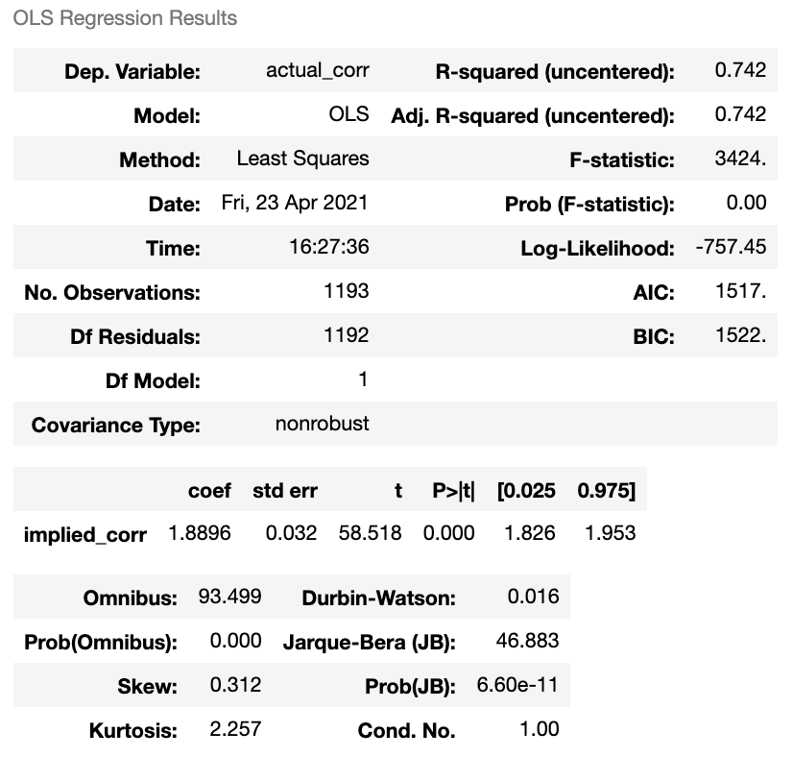
Methodology – Implied volatility Skew correlation
Shifted implied correlation shows strong relationship with actual correlation
Note that actual correlation is criteria for stock selection, but shifted implied correlation tells us when we should change our portfolio’s construction
Value of regression coefficient irrelevant

Slide 14
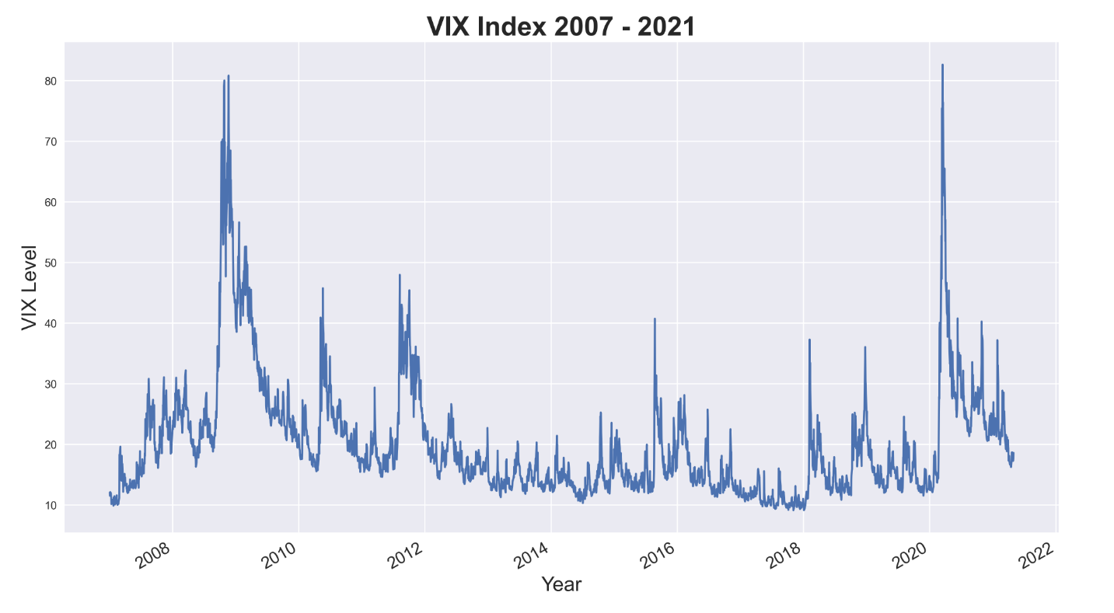
Backtesting

Slide 15
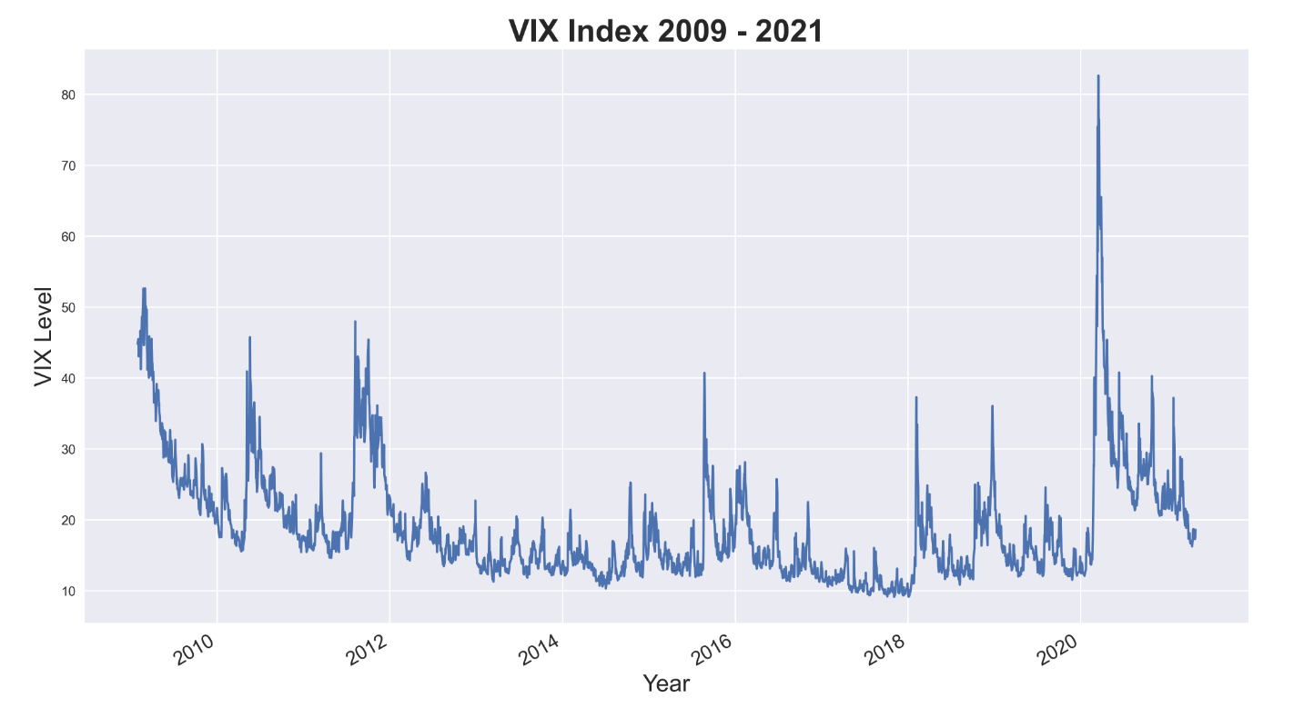
Backtesting
Assets Price

Slide 16
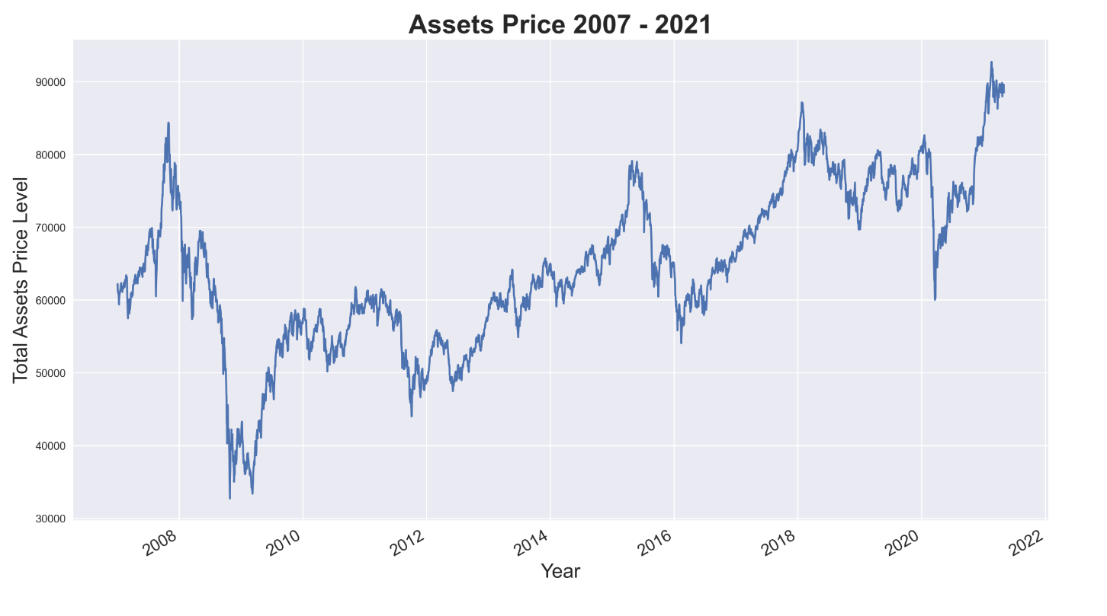
Backtesting

Slide 17
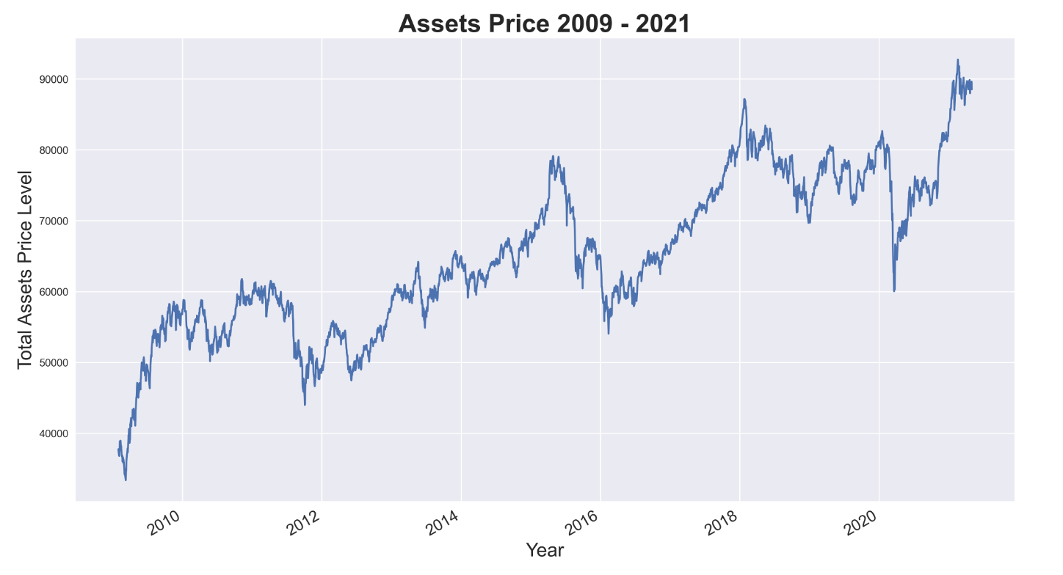
Backtesting

Slide 18
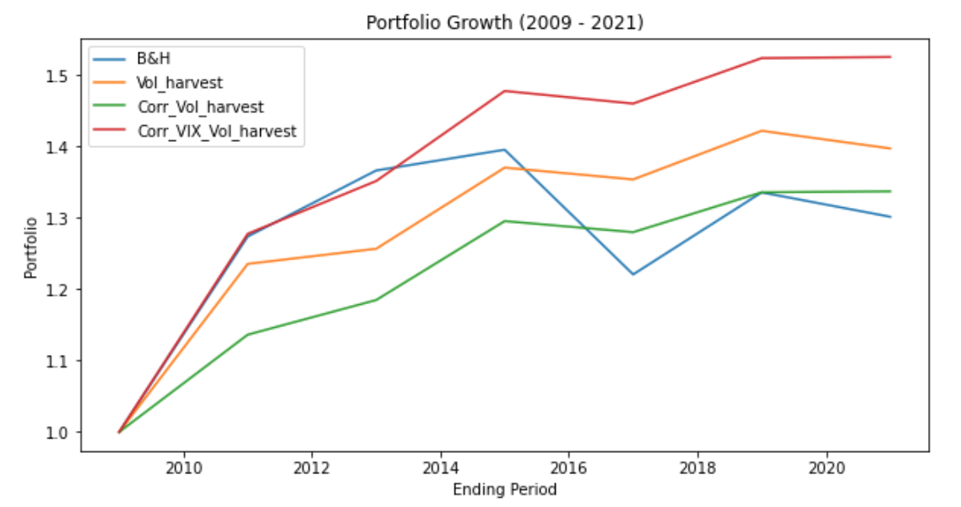
Backtesting (Portfolio Growth 2009-2021)
Calibration:
Correlation shift: Year 2006-2007
Train set: Years: 2007 – 2009
- calibrating optimal parameters
Test set: 2009 - 2021
Optimal parameters:
Correlation window = 90 days
Minimum shift window = 11 days
Minimum correlation window = 7 days
Correlation quantile = 0.3
Volatility harvest window = 12
VIX target = 45%
Sharpe ratio (Annualized)
B&H: 0.274
Vol_harvest: 0.453
Corr_Vol_harvest: 0.642
Corr_VIX_Vol_harvest: 0.515
Notes:
Optimal parameters:
Correlation window = 90 days (Coinciding with 3M maturity options)
Minimum shift window = 11 days (floor on correlation shift signals)
Minimum correlation window = 7 days (if there is a prior correlation signal within 7 days, don’t add another signal)
Correlation quantile = 0.3 (select bottom 30% correlation in portfolio)
Volatility harvest window = 12 days (if no signal, implement volatility harvest rebalancing)
VIX target = 45% (above target, add in VIX signal)

Slide 19
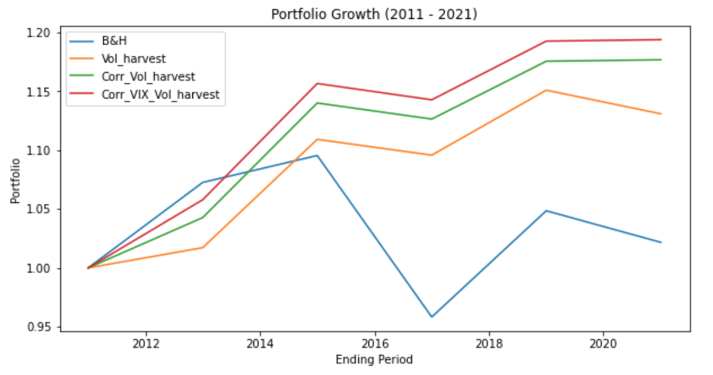
Backtesting (Portfolio Growth 2011-2021)
Sharpe ratio (Annualized)
B&H: 0.06
Vol_harvest: 0.402
Corr_Vol_harvest: 0.575
Corr_VIX_Vol_harvest: 0.6068
Notes:
Optimal parameters:
Correlation window = 90 days (Coinciding with 3M maturity options)
Minimum shift window = 11 days (floor on correlation shift signals)
Minimum correlation window = 7 days (if there is a prior correlation signal within 7 days, don’t add another signal)
Correlation quantile = 0.3 (select bottom 30% correlation in portfolio)
Volatility harvest window = 12 days (if no signal, implement volatility harvest rebalancing)
VIX target = 45% (above target, add in VIX signal)

Slide 20
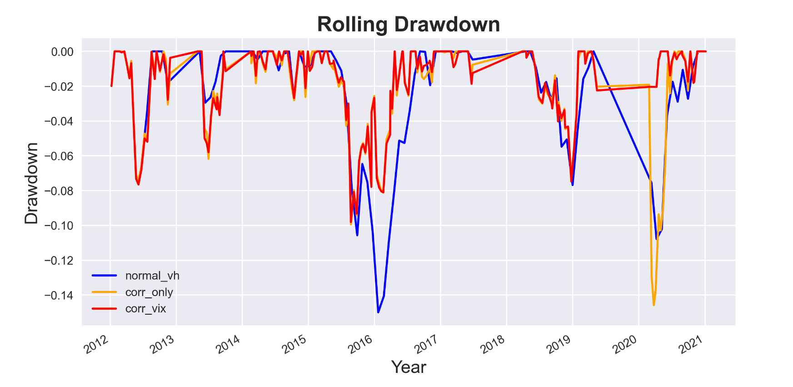
Backtesting (Rolling Drawdown)
Observations:
Normal volatility harvesting still exposed to certain levels of downside risks during crisis periods
Using correlation signals allows for better responses as portfolio concentrates on fewer stocks
VIX signals improves this further by exiting the market before extreme losses (e.g. AY2020)

Slide 21
Conclusion
Normal Volatility harvesting strategy with one month rebalancing outperforms B&H portfolio in our backtesting
01
Rebalancing strategy based on correlation may not outperform normal volatility harvesting strategy, and portfolio cannot benefit from low correlation in stress market
02
03
VIX signal protects portfolio from crisis risk
Combination of VIX and correlation signal achieves persistent portfolio growth and avoid Covid-19 market crash successfully
04
05
Robust combination signal prevent over rebalancing and reduce transaction cost

Slide 22
Limitation
We use first year datapoint to derive each pair correlation optimal shift, but optimal shift can vary from time to time
01
17 assets may not be enough to optimize diversification effect, more qualified assets in other markets may improve the strategy further
02
Our strategy is implemented through equity index, bond, FX and commodity futures assets, strategy may not perform well in one asset class due to strict assets selection
03
Backtesting in longer period that covers whole economic cycle can better illustrate the strategy performance and validate the robustness of signal.
04

Slide 23
Thank You

